Slide 1
Optical Fiber Communication

Slide 2
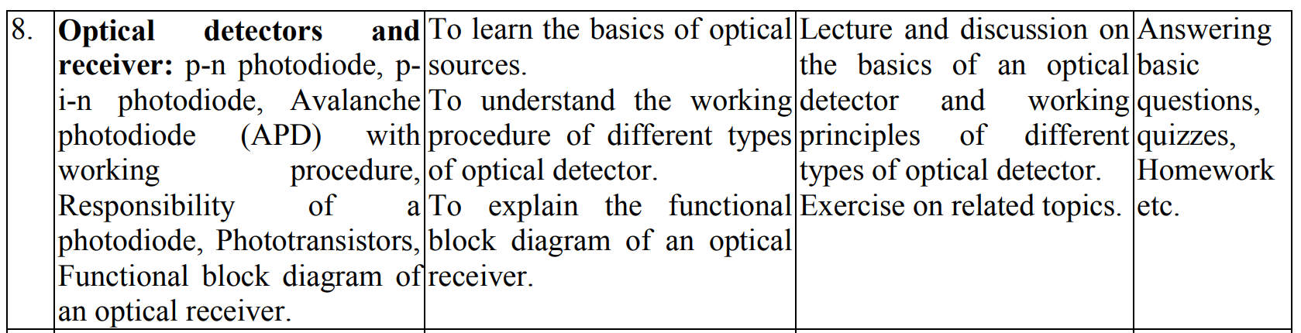

Slide 3
Optical Detectors

Slide 4
p-n Photodiode

Slide 5
p-n Photodiode
A photodiode is a p-n junction diode that will conduct current when exposed to light. This diode is actually designed to operate in the reverse bias mode. It means that larger the intensity of falling light, the greater will be the reverse bias current.
Photodiodes can be manufactured from a variety of materials. But not limited to, Silicon, Germanium, and Indium Gallium Arsenide. Each material uses different properties for cost benefits, increased sensitivity, wavelength range, low noise levels, or even response speed.

Slide 6
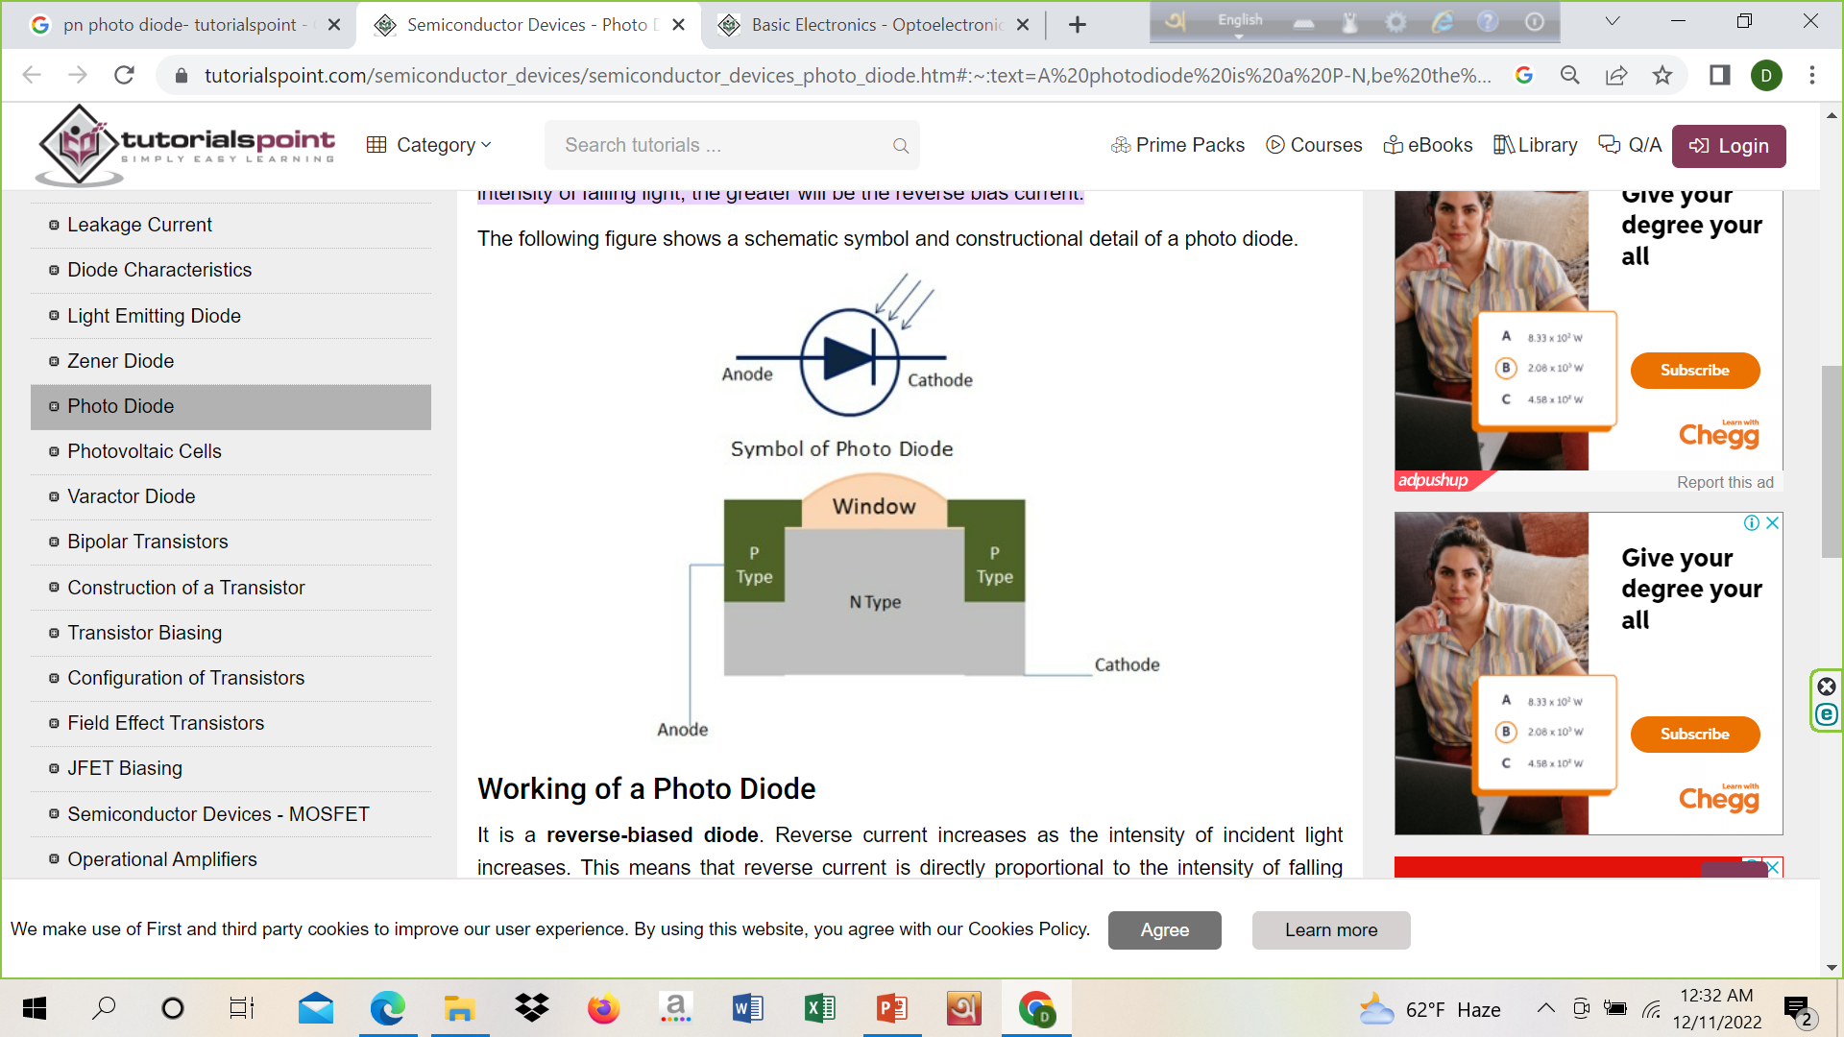
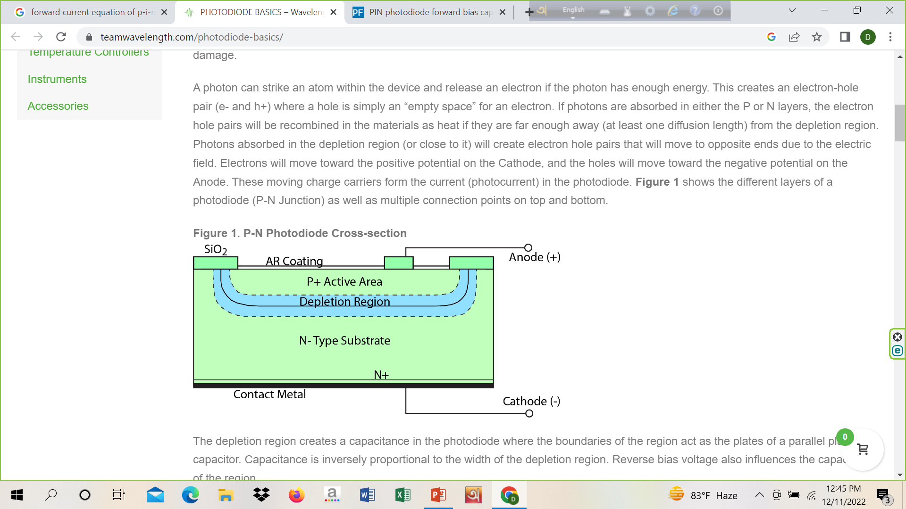
Symbol and Construction

Slide 7
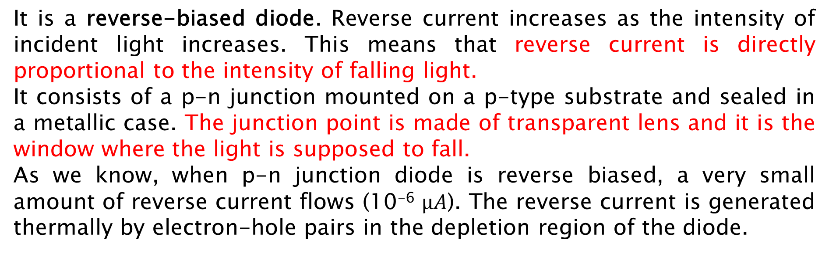
Working of a p-n Photodiode
It is a reverse-biased diode. Reverse current increases as the intensity of incident light increases. This means that reverse current is directly proportional to the intensity of falling light.
It consists of a p-n junction mounted on a p-type substrate and sealed in a metallic case. The junction point is made of transparent lens and it is the window where the light is supposed to fall.
As we know, when p-n junction diode is reverse biased, a very small amount of reverse current flows (10⁻⁶ $µA$). The reverse current is generated thermally by electron-hole pairs in the depletion region of the diode.

Slide 8
Working of a p-n Photodiode
When light falls on p-n junction, it is absorbed by the junction. This will generate more electron-hole pairs. Or we can say, characteristically, the amount of reverse current increases.
In other words, as the intensity of falling light increases, resistance of the p-n junction diode decreases.
This action makes the diode more conductive.
These diodes have very fast response time
These are used in high computing devices.
It is also used in alarm circuits, counter circuits, etc.

Slide 9
Working of a p-n Photodiode
A photon can strike an atom within the device and release an electron if the photon has enough energy. This creates an electron-hole pair (e- and h+) where a hole is simply an “empty space” for an electron. If photons are absorbed in either the P or N layers, the electron hole pairs will be recombined in the materials as heat if they are far enough away (at least one diffusion length) from the depletion region. Photons absorbed in the depletion region (or close to it) will create electron hole pairs that will move to opposite ends due to the electric field. Electrons will move toward the positive potential and the holes will move toward the negative potential. These moving charge carriers form the current (photocurrent) in the photodiode. The depletion region creates a capacitance in the photodiode where the boundaries of the region act as the plates of a parallel plate capacitor. Capacitance is inversely proportional to the width of the depletion region. Reverse bias voltage also influences the capacitance of the region.

Slide 10
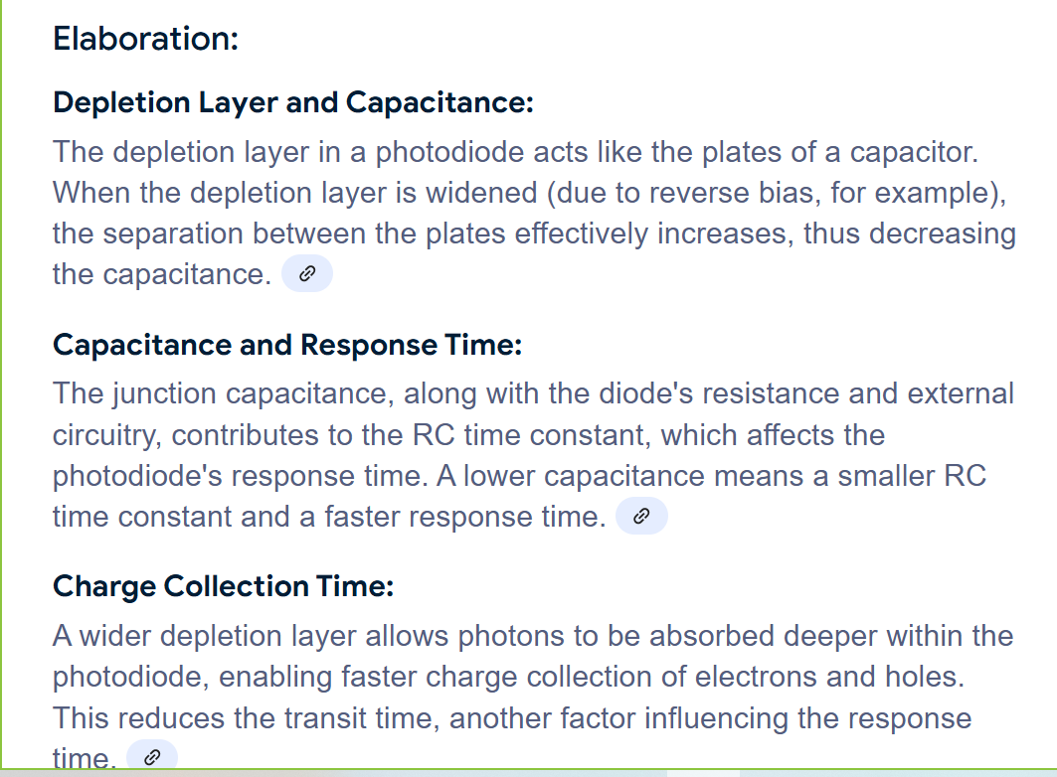

Slide 11
Key performances
Response (speed/time) of the photodiode is determined by the capacitance of the p-n junction. It is the time needed for charge carriers to cross the p-n junction. This is directly affected by the width of the depletion region.
Responsivity is the ratio of photocurrent generated from incident light, to that incident light power. This is usually expressed in units of A/W (current over power). Responsivity is the function of wavelength. This is called Quantum Efficiency.
Dark current is the current in the photodiode when there is no incident light. This can be one of the main sources of noise in the photodiode system. Photocurrent from background radiation can also be included in this measurement.

Slide 12
Key performances
Photodiodes are usually put into an enclosure that does not allow any light to hit the photodiode to measure the dark current. Because the current generated by the photodiode can be very small, dark current levels can obscure the current produced by incident light at low light levels. Dark current increases with temperature. The ideal photodiode would have no dark current.
Breakdown Voltage is the largest reverse voltage that can be applied to the photodiode before there is an exponential increase in leakage current or dark current. Photodiodes should be operated below this maximum applied reverse bias or damage to the photodiode may occur. Breakdown voltage decreases with an increase in temperature.

Slide 13
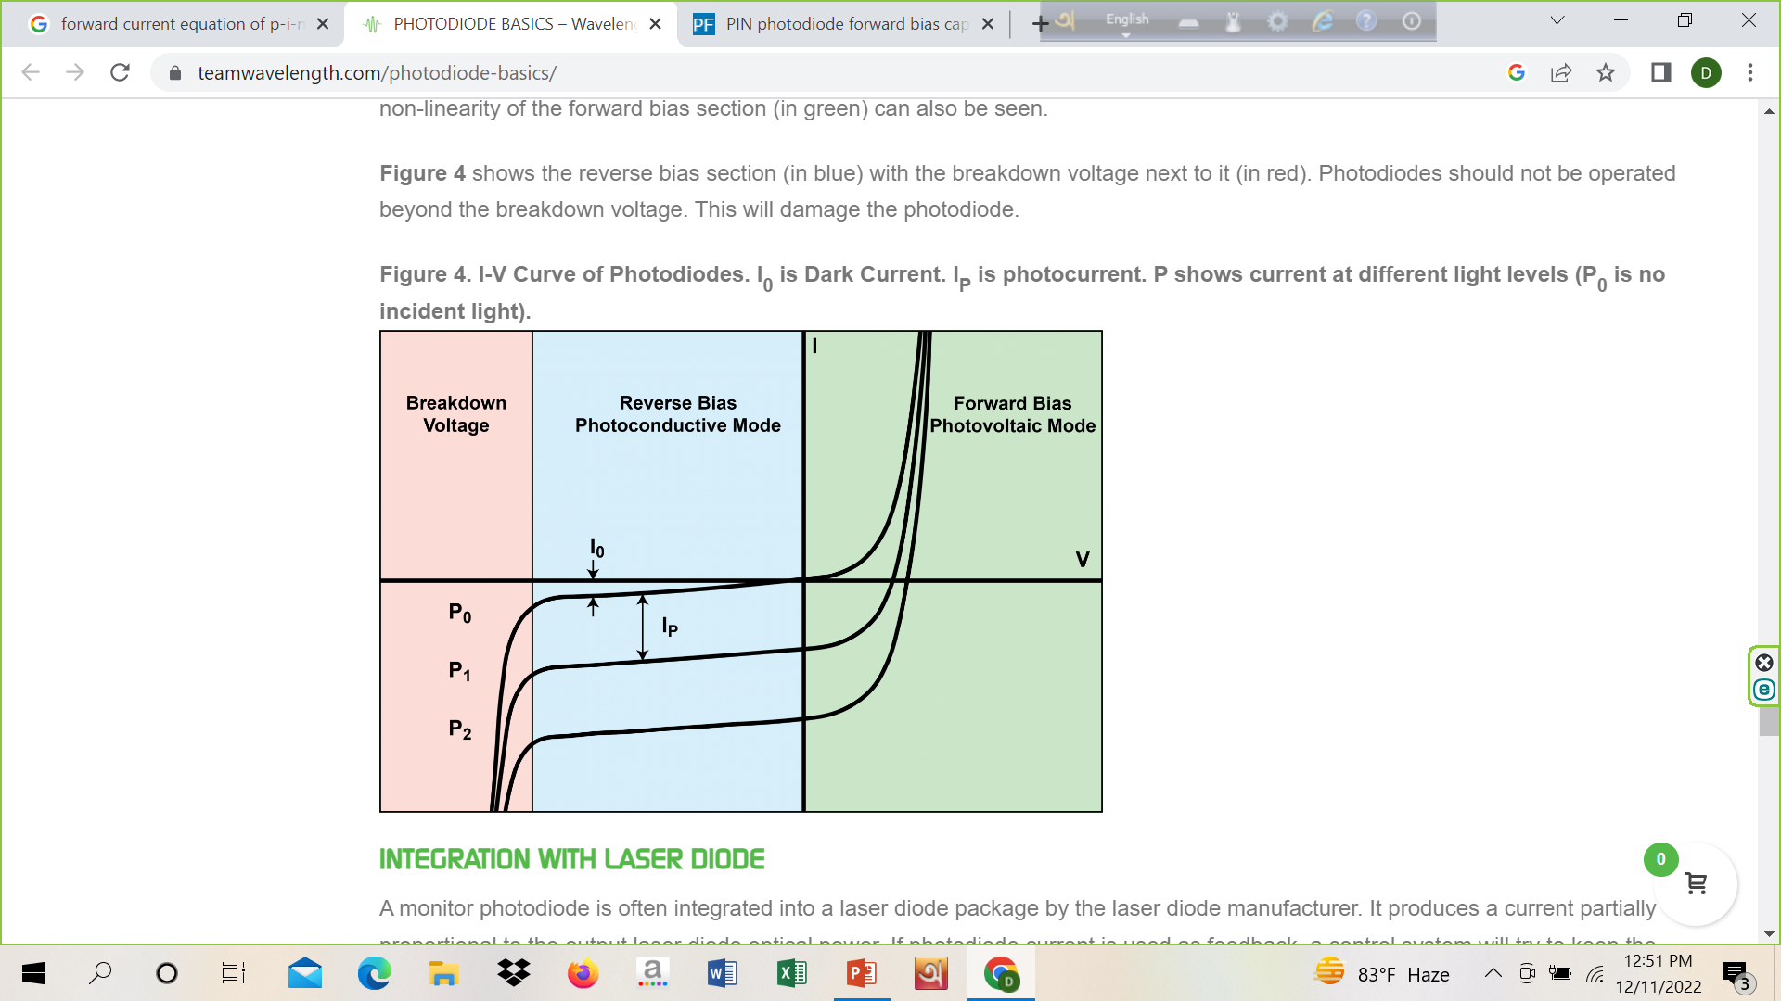

Slide 14
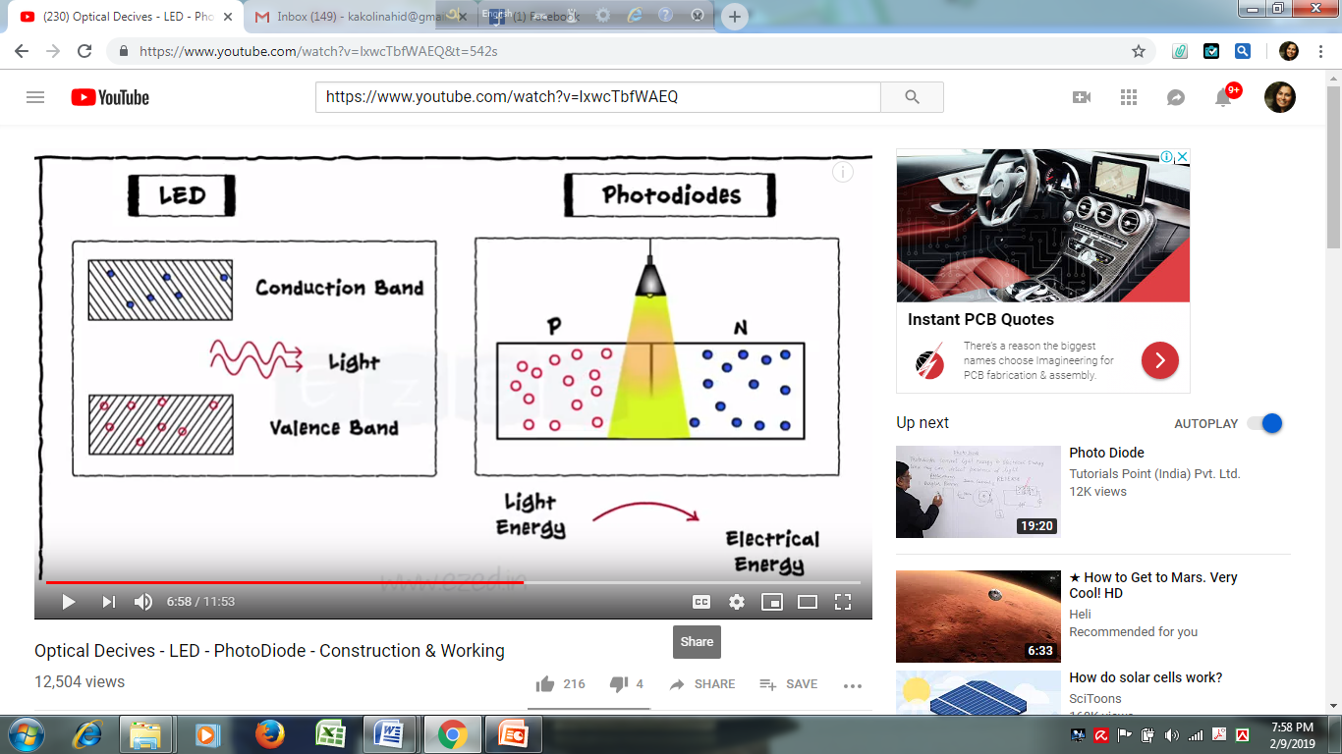
Photodiodes

Slide 15
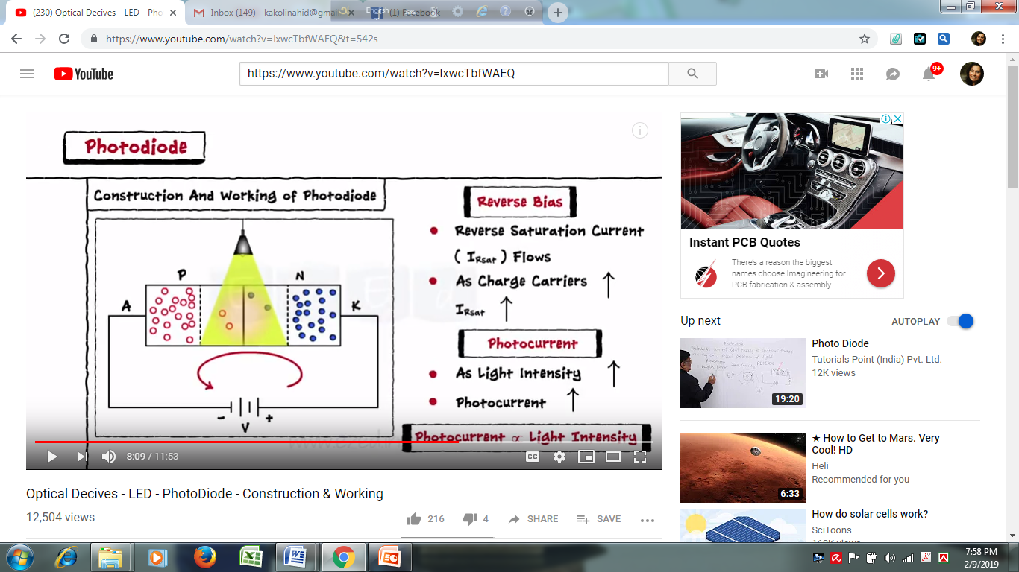
Working Principle

Slide 16

Working Principle

Slide 17

Advantages & Disadvantages

Slide 18
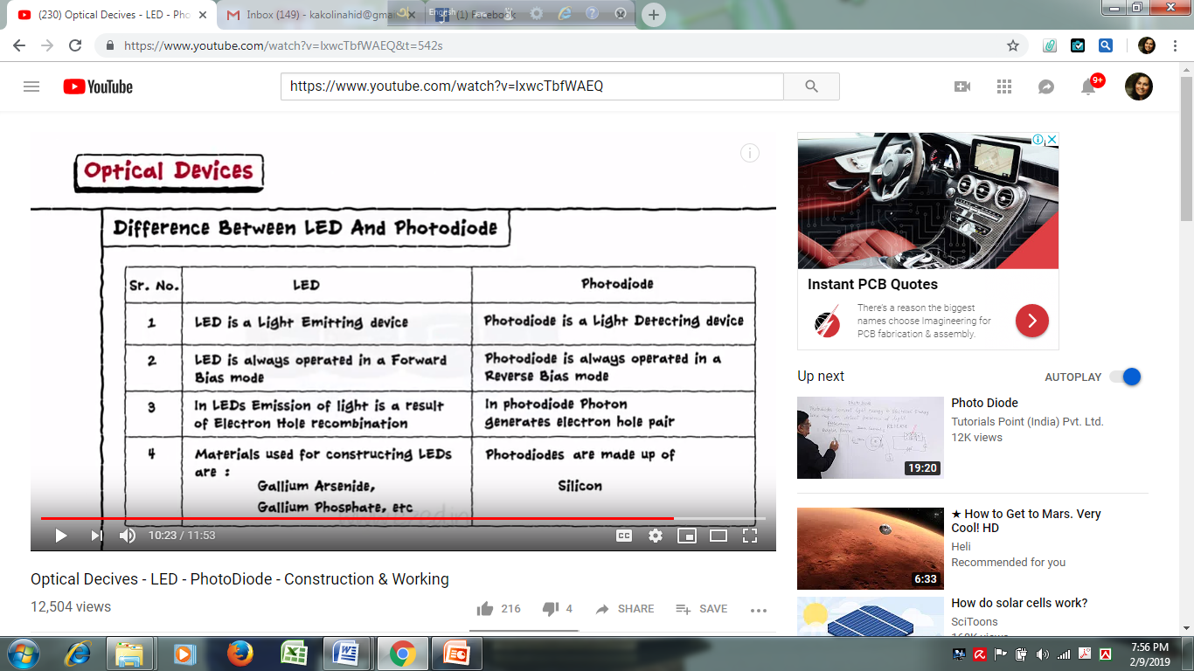
Differences between LED & Photodiode

Slide 19
p-i-n Photodiode

Slide 20
p-i-n Photodiode
A diode with a wide and undoped intrinsic semiconductor region between a p-type and an n-type semiconductor region. These two regions are primely heavily doped as they find applications for ohmic contacts.
The p-i-n diode was first used in the year 1952 as a low frequency and high power rectifier. It was even used for microwave applications and as a photodetector as it is said to be a good light absorber.

Slide 21
p-i-n Photodiode
The switching speed can be enhanced by a small minority carrier lifetime. For the photo detector applications where the speed of response is important, the depletion region width should be made as large as possible for small minority carrier lifetime as a result the switch speed also increases. This can be achieved p-i-n photodiode as the insertion of intrinsic region the space charge width larger.

Slide 22
p-i-n Photodiode
This intrinsic layer is highly resistive and increases the electric field strength in the photodiode. There are many benefits to the added intrinsic layer because the depletion region is greatly increased. The capacitance of the junction is decreased, and so the speed of the photodiode increased. The increased layer also allows for a larger volume of photon to electron-hole conversion and higher Quantum Efficiency, p-i-n photodiodes also have high frequency response. The major advantage of the p-i-n photodiode, compared to the p-n junction, is the high response speed from the increased depletion region.

Slide 23
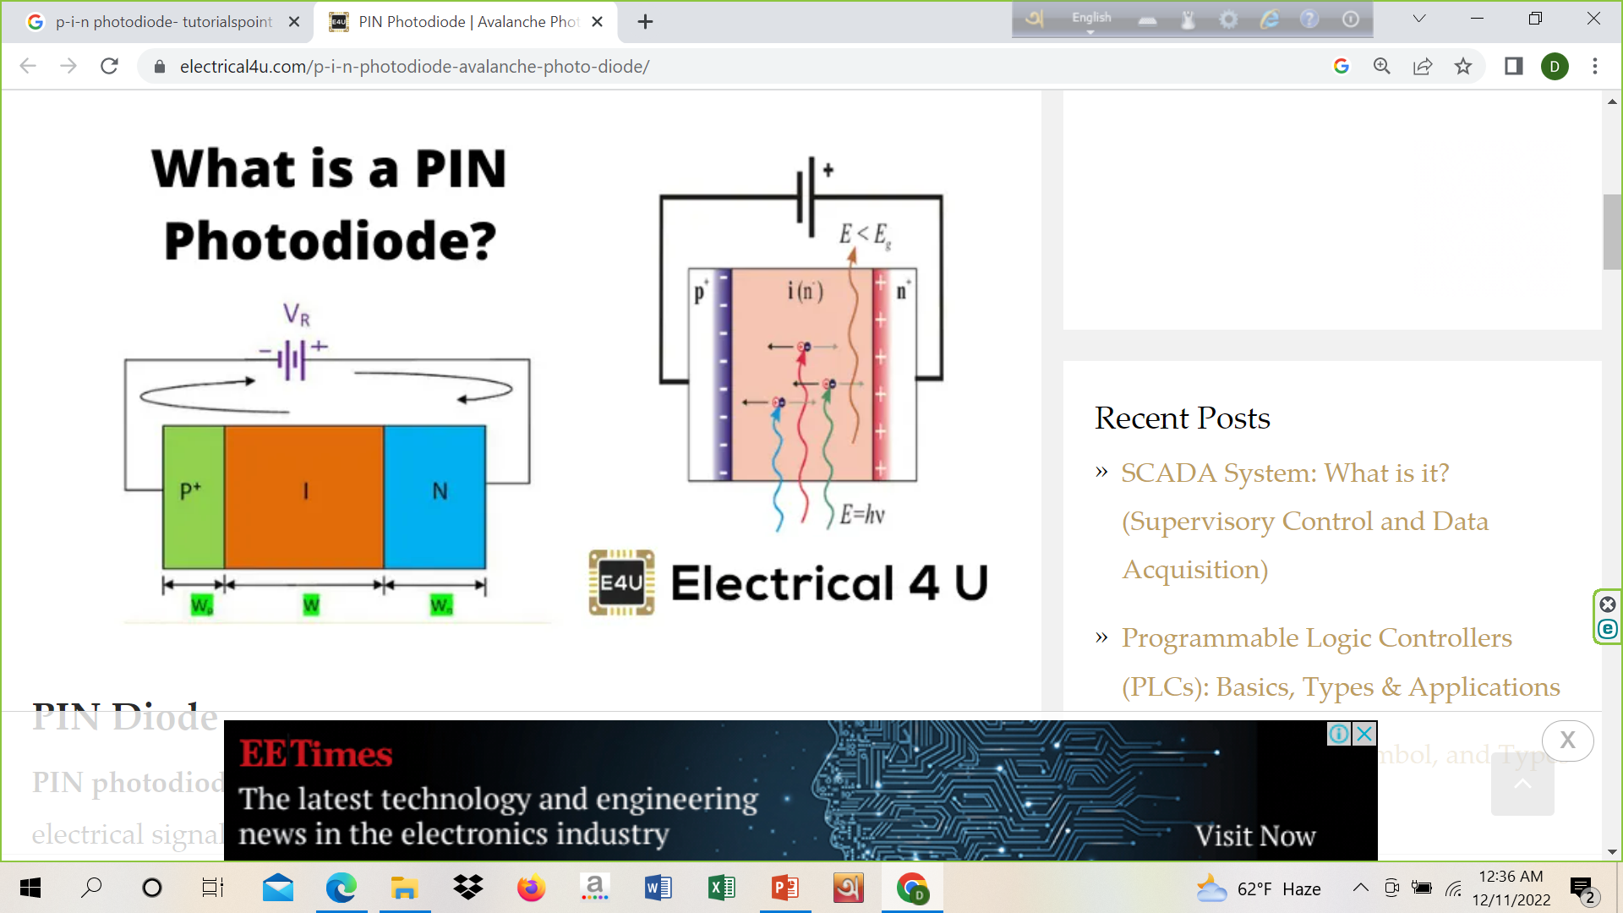
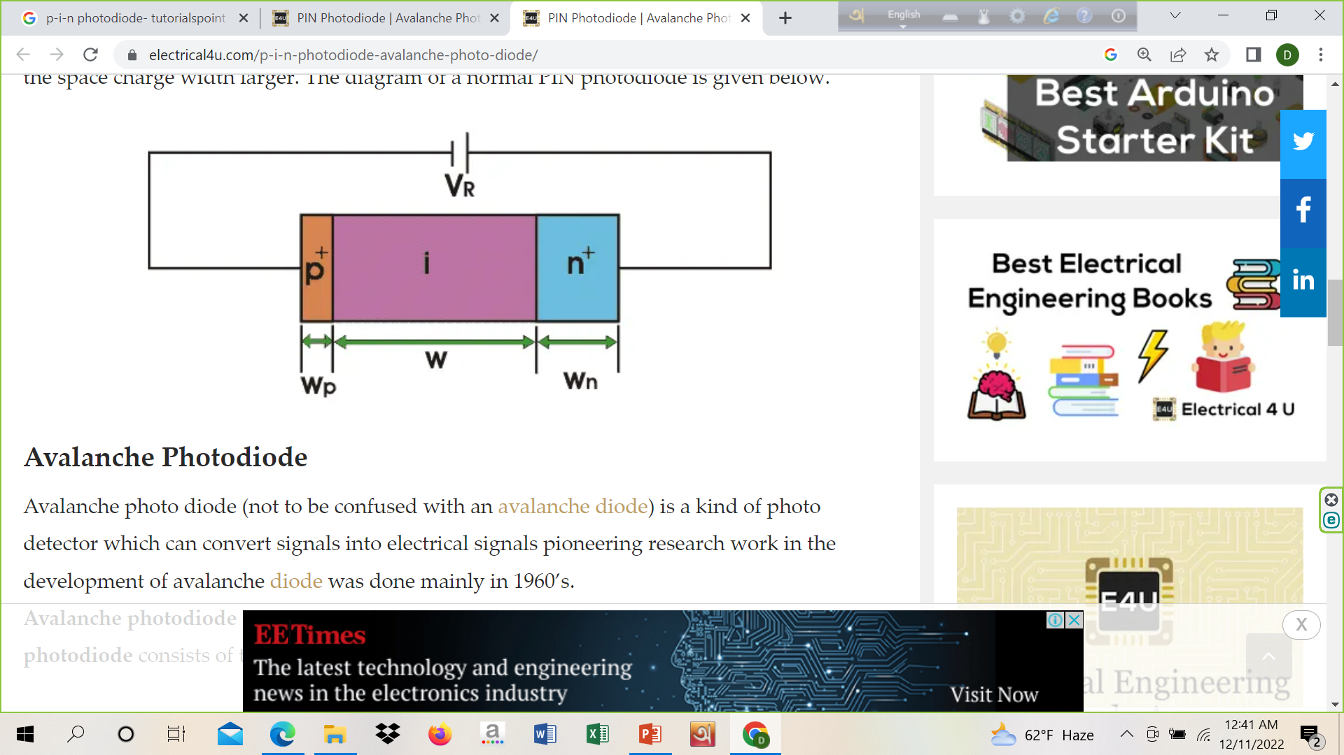
p-i-n Photodiode

Slide 24
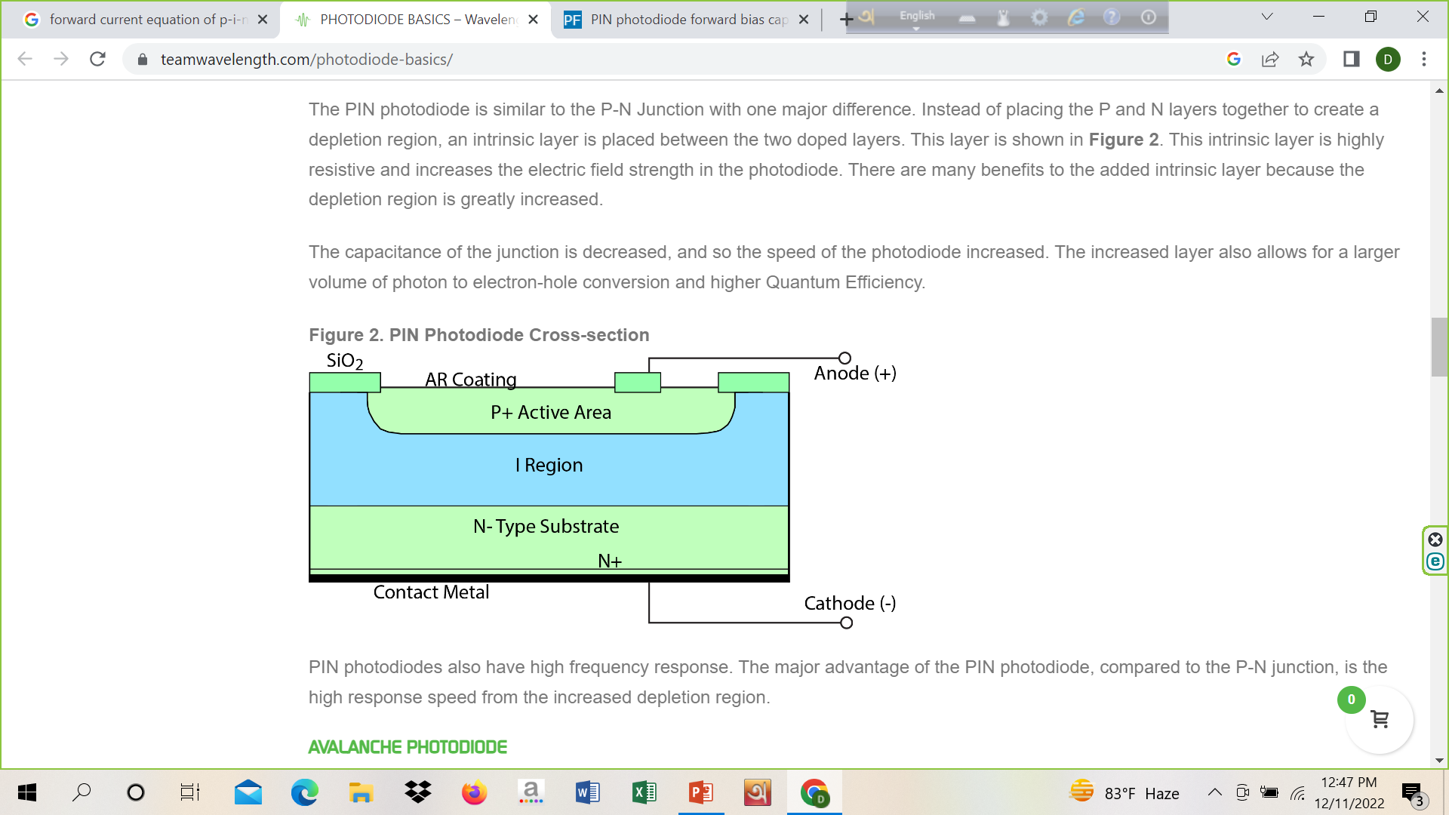

Slide 25
Structure and working
The p-i-n diode comprises a semiconductor diode having three layers naming the p-type layer, intrinsic layer and n-type layer. The p and n regions are there, and the region between them consists of the intrinsic material, and the doping level is said to be very low in this region. The thickness of the intrinsic layer is very narrow, which ranges from 10 – 200 microns. The p region and the n regions are known to be heavily doped.
The changes in the properties of the diode are known from the intrinsic material. These diodes are made of silicon. The intrinsic region of the p-i-n diode acts like an inferior rectifier which is used in various devices such as attenuators, photodetectors, fast switches, high voltage power circuits etc.

Slide 26
Application
p-i-n diode has a wide range of applications coming in various fields of physics like radio frequency switch, microwave switch, radiofrequency attenuator, microwave attenuator, photodetector, etc.
Details are given below-
These diodes are used in the RF and also for microwave switches and microwave variable attenuators since they are said to have low capacitance.
They are used in Photodetectors and photovoltaic cells, and the p-i-n photodiodes are used for fibre optic network cards and switches.
These diodes are effectively used for RF protection circuits, and they can also be utilized as an RF switch.
The p-i-n photodiode is also used to detect X-rays and gamma rays photons.

Slide 27
Other information
p-i-n diode act as a variable capacitor when it is reverse biased.
p-i-n diode act as a variable resistor when it is forward biased.

Slide 28
Avalanche photodiode

Slide 29
Avalanche Photodiode
Avalanche photo diode (not to be confused with an avalanche diode) is a kind of photo detector which can convert signals into electrical signals pioneering research work in the development of avalanche diode was done mainly in 1960’s. Avalanche photodiode structural configuration is very similar to the p-i-n photodiode. A p-i-n photodiode consists of three regions-
p-region
intrinsic region
n-region.
The difference is that reverse bias applied is very large to cause impact ionization. Firstly electron- hole pairs are generated by photon absorption in the depletion region. These generate more electron hole pairs through impact ionization. These are swept out of the depletion region quickly, i.e, the transit time is very less.

Slide 30
Avalanche photodiode
Avalanche photodiodes or APDs are highly sensitive semiconductor devices that transform optical signals into electrical signals. These are operated under high reverse bias. The term ‘avalanche’ comes from the avalanche breakdown phenomenon.

Slide 31
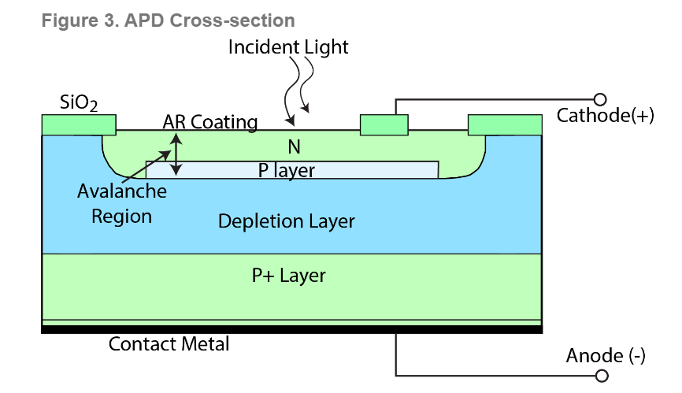

Slide 32
Avalanche photodiode
Avalanche photodiodes (APD) use impact ionization (avalanche effect) to create an internal gain in the material. APDs require high reverse bias operation (near reverse breakdown voltage). Each photo-generated carrier creates more pairs and so is multiplied by avalanche breakdown. This creates internal gain within the photodiode, which in turn increases the effective responsivity (larger current generated per photon). Figure shows the cross section of the APD. The typical spectral response range is around 300 - 1100 nm. Current noise in an APD is higher than in a p-i-n photodiode, but the increased signal gain is much greater making signal to-noise ratio greater in APDs. APDs generally have a higher response speed and the ability to detect or measure light in lower levels.

Slide 33

Symbol

Slide 34
Structure
The structure of the ordinary Avalanche photodiode is similar to the p-i-n photodiode. It consists of two heavily doped (p+ and n+ region) and two lightly doped (I or intrinsic region and P region) regions. The width of the depletion layer in the intrinsic region is relatively thinner in APD than the p-i-n photodiode. The p+ region acts like the anode, and n+ acts like the cathode. Reverse bias is mostly applied across the pn+ region.

Slide 35
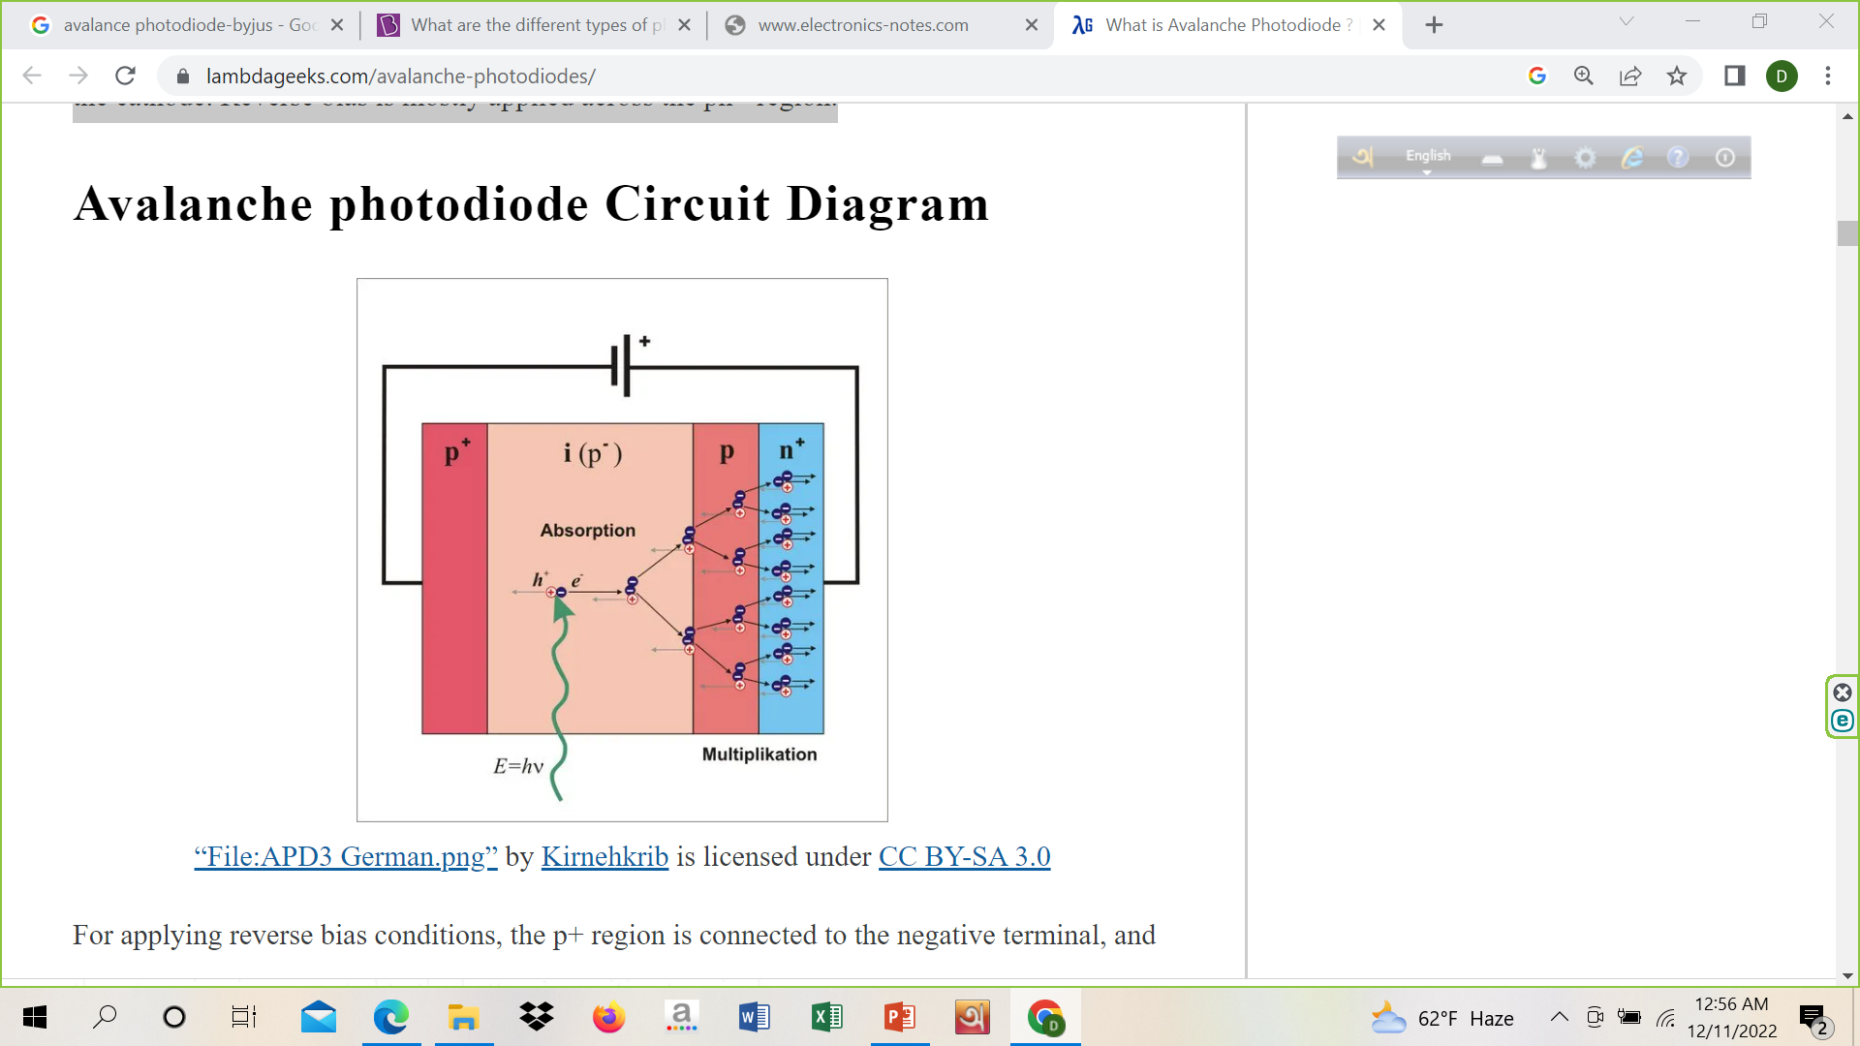
Circuit Diagram
For applying reverse bias conditions, the p+ region is connected to the negative terminal, and the n+ region is connected to the battery’s positive terminal.

Slide 36
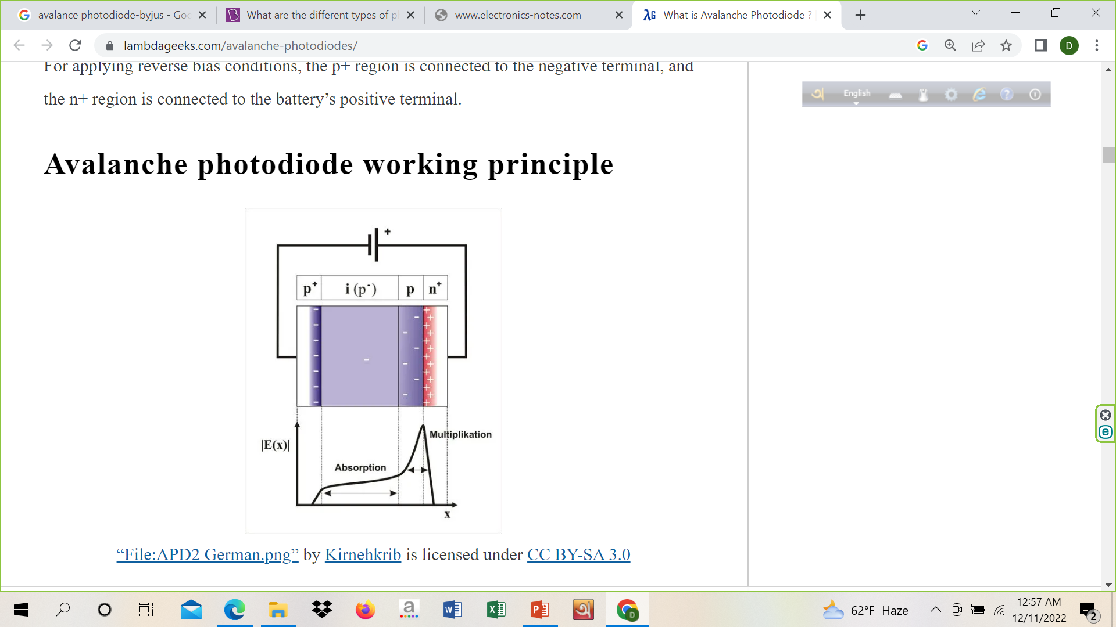

Slide 37
Working
Avalanche breakdown takes place when the diode is subjected to high reverse voltage.
The reverse bias voltage increases the electric field across the depletion layer.
Electron-hole pairs are produced in the highly resistive p region.
A comparatively weaker electric field causes separation between these pairs. Electrons and holes drift with their saturation velocity towards the pn+ region where a high electric field exists.
As the velocity is maximum, the carriers collide with other atoms and generate new electron-hole pairs. A large number of e-h pairs results in high photocurrent.

Slide 38
Characteristics
The intrinsic region in APD is slightly p-type doped. It is also called -region.
The n+ region is thinnest, and it is illuminated through a window.
The electric field is maximum at the pn+ junction, and then it starts decreasing through the p region. Its intensity lessens in
-region and gradually vanishes at the end of the p+ layer.
Even a single photon absorbed leads to the generation of a vast number of electron-hole pairs. This is called the internal gain process.
Excess electron-hole pair generation due to the collision of charge carriers is called avalanche multiplication, multiplication factor or gain.

Slide 39
Impact ionization in Avalanche Photodiodes
After the photons are absorbed in -region, a sufficient number of electron-hole pairs are formed. The electric field separates the pairs, and the independent charge carriers run towards the n+ and p+ regions. In the p region, the electrons experience a massive electric field. In the effect of this field, electrons drift with their saturation velocity and collide. This collision helps in charge multiplication. This overall phenomenon is called impact ionization.

Slide 40
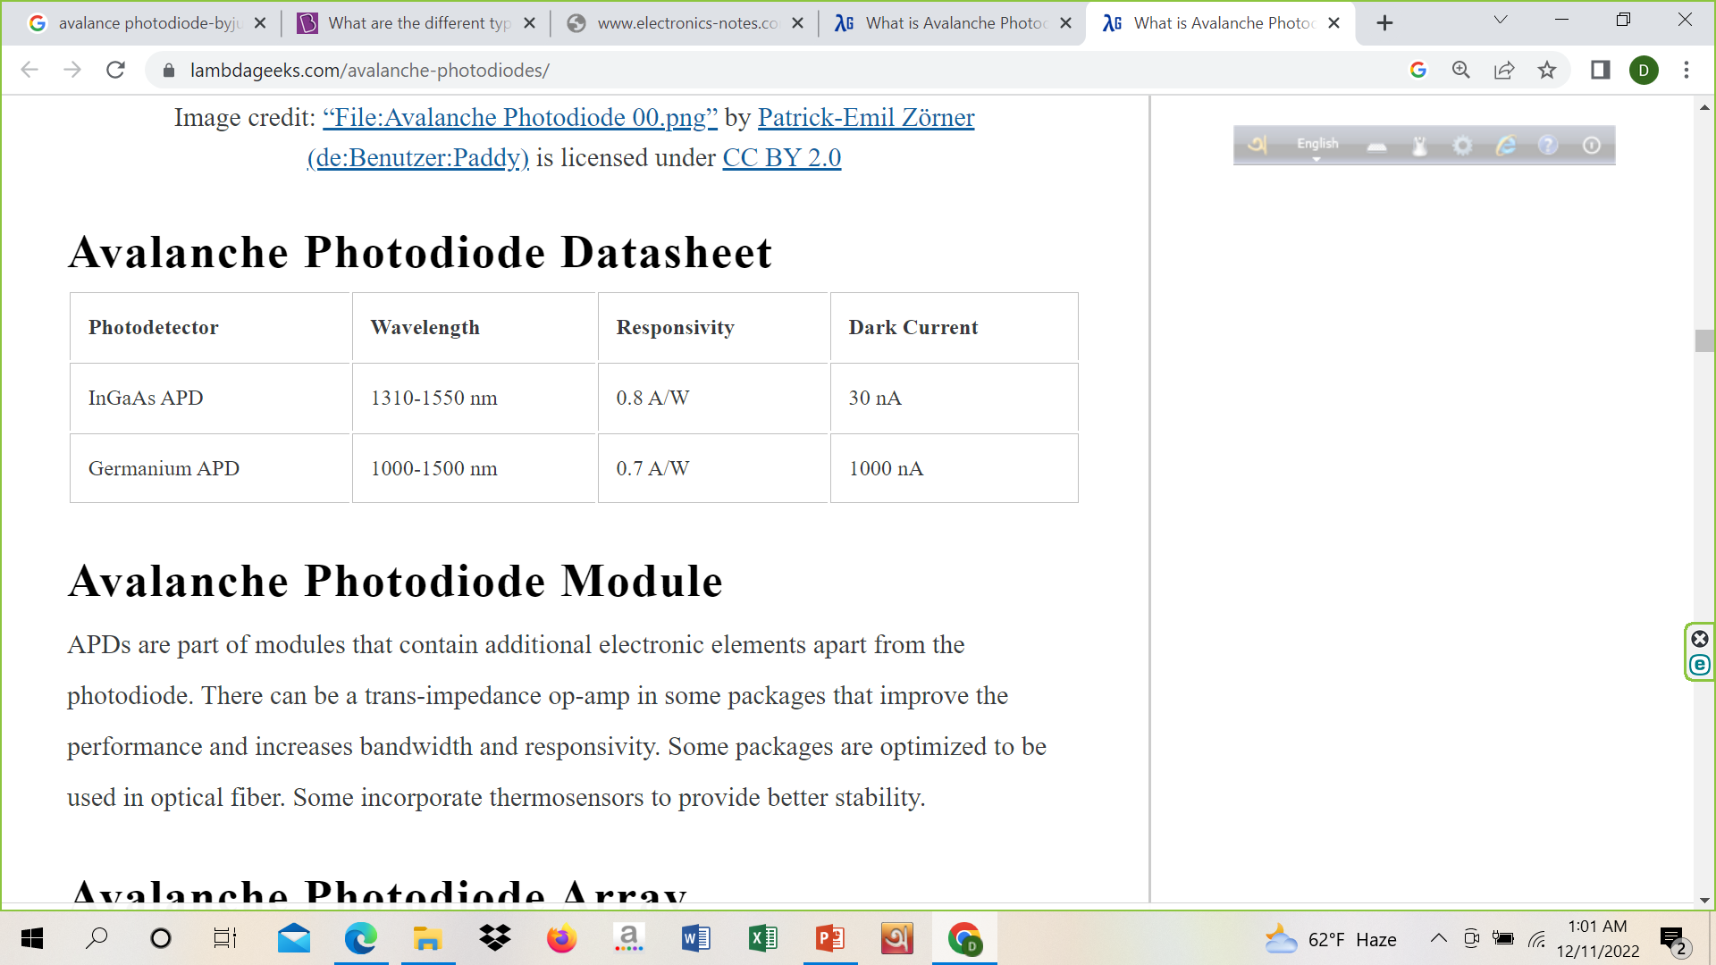

Slide 41
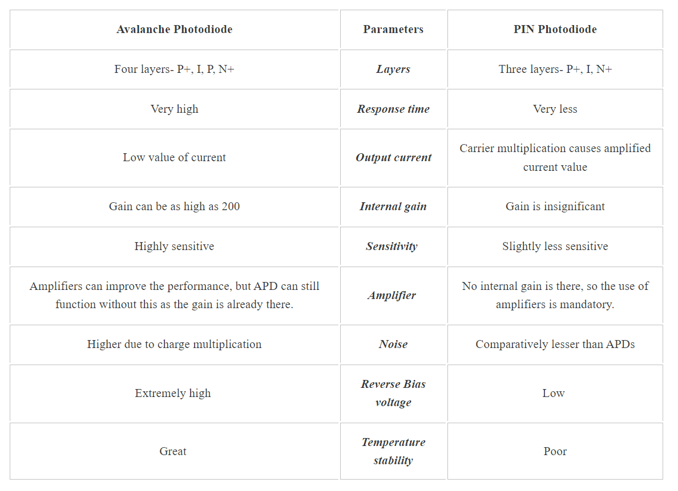
Comparision

Slide 42
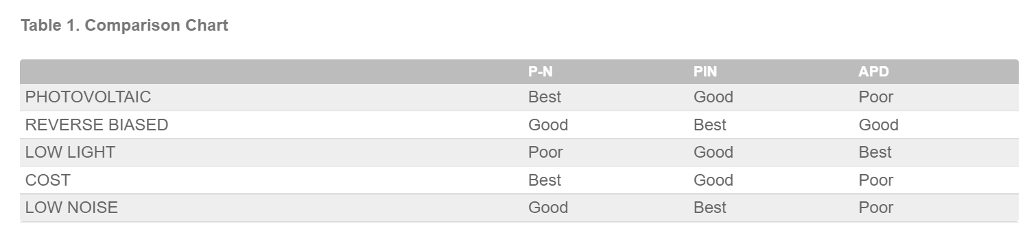
Comparison Chart

